Slide 1
Other Applications of Electromagnetism

Slide 2
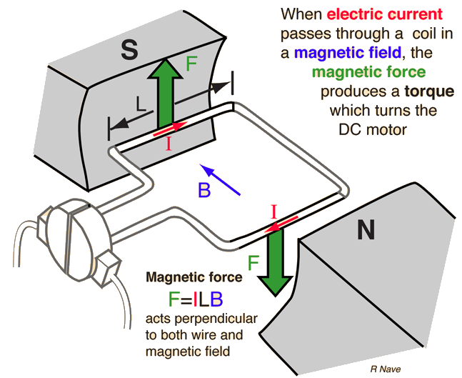
Motors Review
In an electric motor, a current is passed through a coil (a.k.a. armature) in a magnetic field, which applies opposite vertical forces to the two sides of the coil perpendicular to the field.
These forces produce a torque on the coil, causing the shaft to rotate.
As the coil rotates, the split ring commutator regularly reverses the direction of the current, maintaining the direction of the torque on the coil.

Slide 3
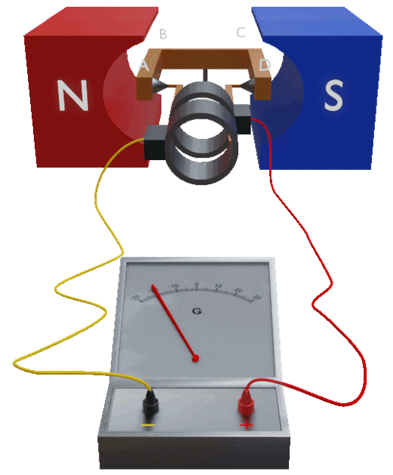
Generators Review
A generator is essentially the opposite of a motor: an external force rotates a coil in a magnetic field, inducing an emf.
Faraday’s law tells us that the magnitude of this emf is proportional to the change in magnetic flux over time.
Lenz’s law tells us that the induced current produces a magnetic field that opposes the change in flux.
So what do we find if we apply these laws to a motor?

Slide 4
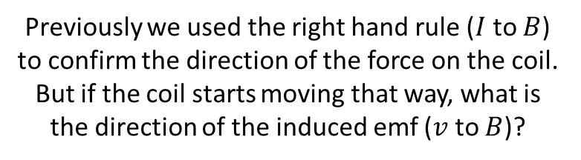
Back emf
As a motor armature rotates, the magnetic flux through it changes:
It is 0 when the armature is parallel to the field
It reaches a maximum when the armature is perpendicular to the field
By applying Faraday’s law and Lenz’s law, we can see that the motor will act as a generator: an emf will be induced to oppose the change in flux.
Since the direction of this emf is opposite to that of the emf applied by the power supply, it is called back emf (or counter emf).
Previously we used the right hand rule ($I$ to $B$) to confirm the direction of the force on the coil. But if the coil starts moving that way, what is the direction of the induced emf ($v$ to $B$)?

Slide 5
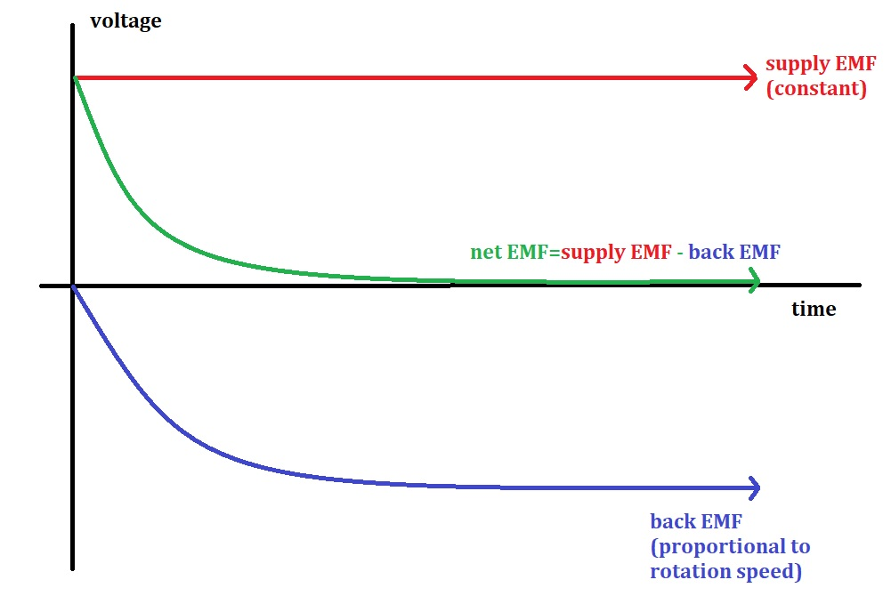
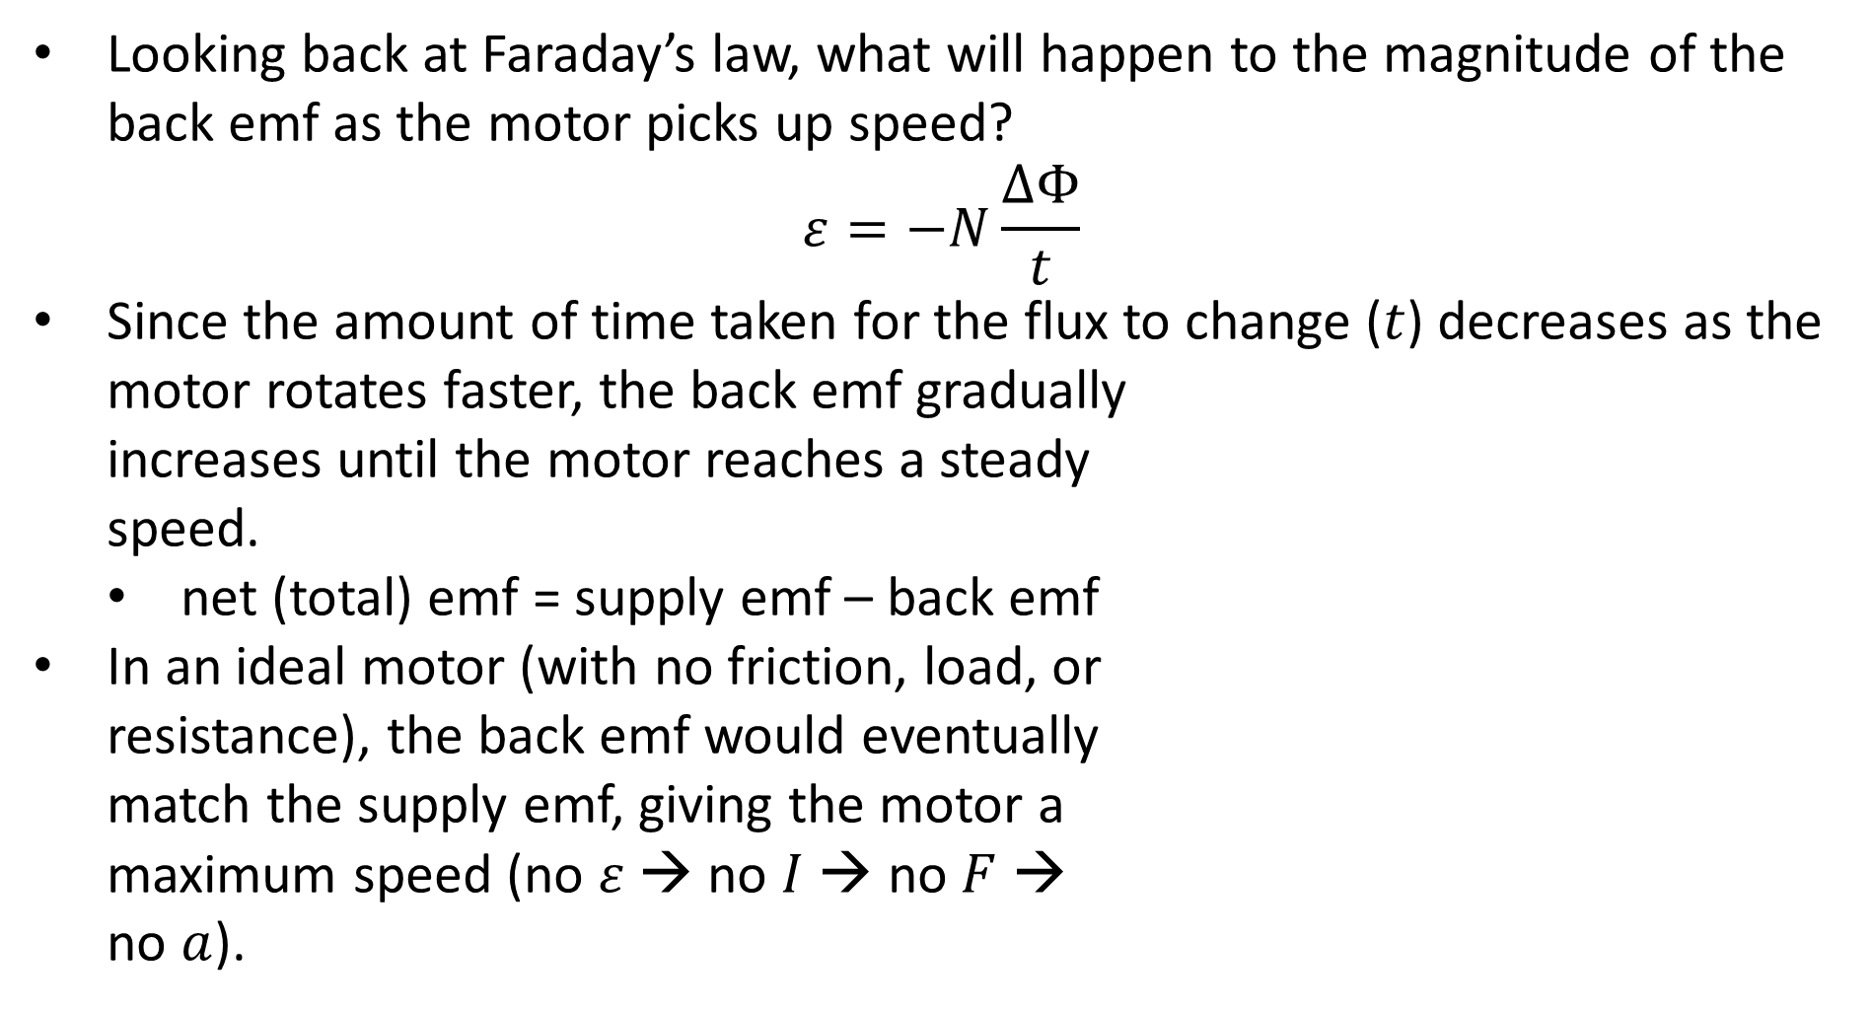
Back emf
Looking back at Faraday’s law, what will happen to the magnitude of the back emf as the motor picks up speed?
$$ε=−N\frac{ΔΦ}{t}$$
Since the amount of time taken for the flux to change ($t$) decreases as the motor rotates faster, the back emf gradually increases until the motor reaches a steady speed.
net (total) emf = supply emf – back emf
In an ideal motor (with no friction, load, or resistance), the back emf would eventually match the supply emf, giving the motor a maximum speed (no $ε$ → no $I$ → no $F$ → no $a$).

Slide 6
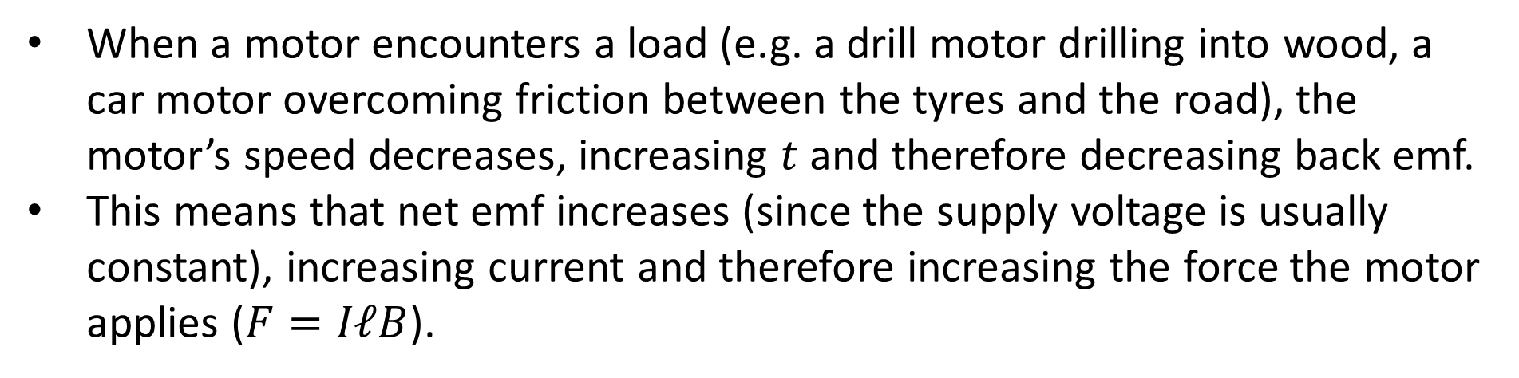
Back emf
When a motor encounters a load (e.g. a drill motor drilling into wood, a car motor overcoming friction between the tyres and the road), the motor’s speed decreases, increasing $t$ and therefore decreasing back emf.
This means that net emf increases (since the supply voltage is usually constant), increasing current and therefore increasing the force the motor applies ($F=IℓB$).

Slide 7
Example #1
A fan motor with a resistance of 5.00 Ω is connected to a 120 V power supply. When the motor reaches full speed under normal load, it produces a back emf of 108 V.
What is the start-up (initial) current in the armature?
What is the current in the armature when the motor is running at full speed?
Wanting to prove how tough he is, a somewhat insecure lower school student sticks his hand into the fan, causing it to come to a sudden stop (and causing him a considerable amount of pain). What effect will this have on the:
Net emf of the circuit?
Condition of the motor, especially if it is held still for a longer period of time?
Notes:
24 A (it is not unusual for the start-up current to be significantly higher than the FLC (full load current) – the heat this can cause can damage the motor, especially if it is started and stopped frequently over a short time period)
2.4 A
Back emf will suddenly vanish, so net emf will return to 120 V and current will return to 24 A. This will quickly overheat the motor, potentially melting or distorting parts of it or its casing. Note that circuits with motors in them are usually designed with measures to protect themselves from this.

Slide 8
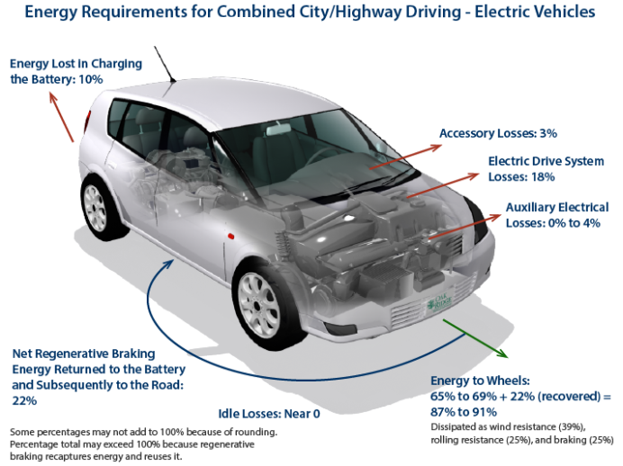
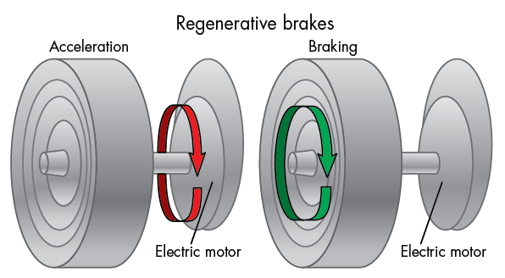
Regenerative Braking
When traditional vehicles brake, their kinetic energy is wasted as heat.
Induction allows electric and hybrid vehicles to use their own motors as generators, turning their kinetic energy into electrical energy that can be stored in capacitors or used to charge their batteries.
Whenever the driver is not accelerating, the rotation of the wheels is used to rotate the coil inside the motor, causing it to behave as a generator.

Slide 9
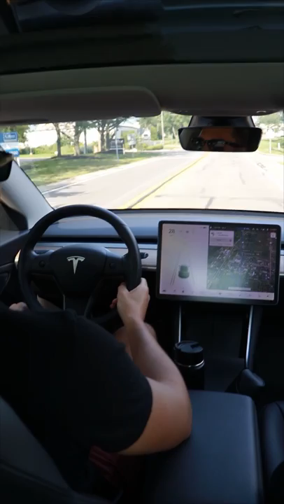
Regenerative Braking
Lenz’s law demands that the induced current opposes the change in flux, so the wheels experience a torque in the opposite direction to their motion.
This causes vehicles with regenerative braking to slow down significantly even when the brake pedal is not being pressed.
(Traditional cars would generally coast in these situations, maintaining as much speed as possible.)

Slide 10
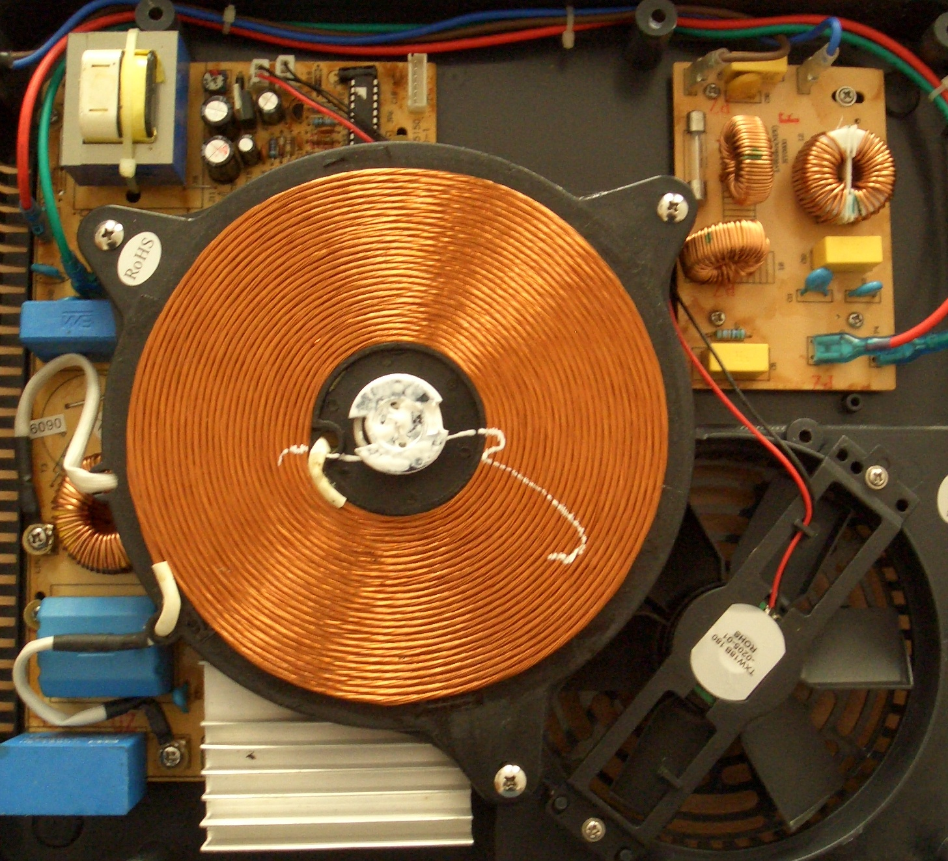
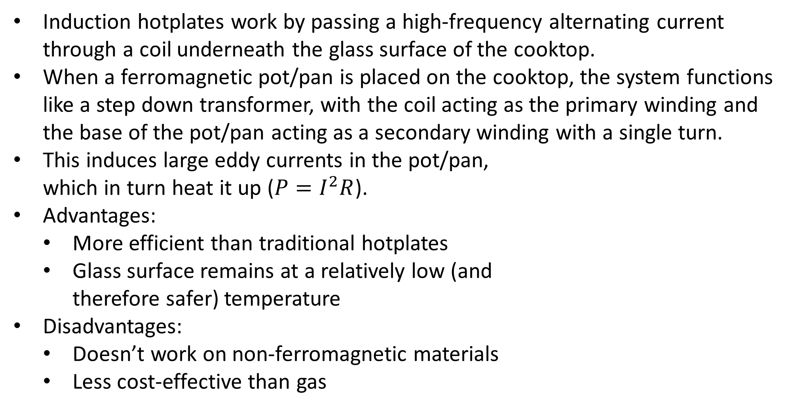
Induction Hotplates
Induction hotplates work by passing a high-frequency alternating current through a coil underneath the glass surface of the cooktop.
When a ferromagnetic pot/pan is placed on the cooktop, the system functions like a step down transformer, with the coil acting as the primary winding and the base of the pot/pan acting as a secondary winding with a single turn.
This induces large eddy currents in the pot/pan, which in turn heat it up ($P=I^{2}R$).
Advantages:
More efficient than traditional hotplates
Glass surface remains at a relatively low (and therefore safer) temperature
Disadvantages:
Doesn’t work on non-ferromagnetic materials
Less cost-effective than gas

Slide 11
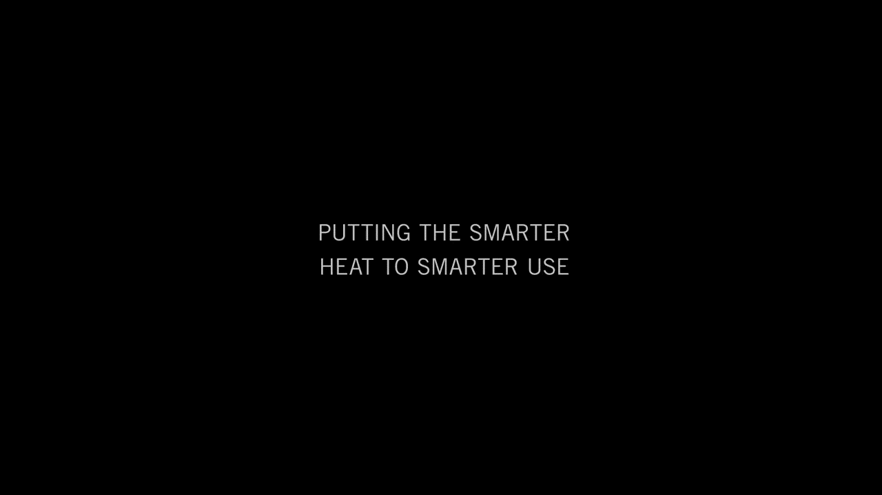
Notes:
Note that the animation showing the cross-section of the bar (1:40-1:45) isn’t very accurate – there should really be one big eddy current (or a number of concentric ones).
There’s another great video at https://youtu.be/wKFnk4R54ZQ

